Slide 1

Section 1 – the Balancing Section
CANADIAN CHARTER OF RIGHTS AND FREEDOMS
Patricia Paradis
February 24, 2021

Slide 2
Agenda
What this presentation will not cover
History of section 1
Purpose
Approach to interpretation used by the courts
Examples of its prior use
Scenarios for its future use – hypotheticals

Slide 3
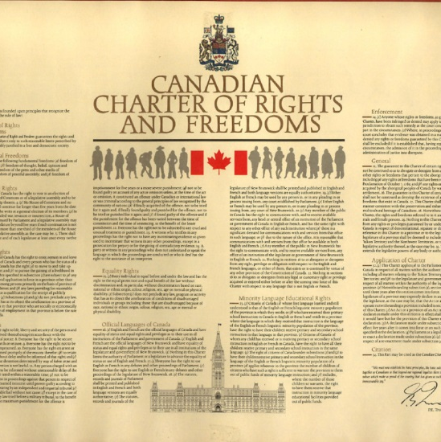
Anatomy of the Charter
Part 1 of the Constitution Act 1982
Limitations clause – section 1
Rights and Freedoms – sections 2 – 23
Remedies – section 24
General provisions re: interpretation – sections 25 – 31
Application - section 32
Notwithstanding Clause – section 33
Name – section 34

Slide 4
Section 1 - Why Limit Rights?
Some rights and freedoms may have to be curtailed for the good of society as a whole
Rights and Freedoms in the Charter cannot be absolute
  Cannot willfully incite hate against identifiable groups – hate is the type of expression that can be limited

Slide 5
History of section 1
1960’s drafts aimed at preserving provincial legislative jurisdiction – provinces opposed to a charter of rights
1978 – Bill C-60 – Clause 25 – Public safety, health, peace and security of the public, interest of the rights and freedoms of others - International human rights instruments
1980 - “Mack Truck Clause”:
  “ The Canadian Charter of Rights and Freedoms guarantees the rights and freedoms set out in it subject only to such reasonable limits prescribed by law as are generally accepted in a free and democratic society with a Parliamentary system of government”
Notes:
The limitations clause attracted more commentary than any other clause at the Joint Hays-Joyal Committee and almost all of it was negative. It was dubbed the “Mack Truck clause” because it was so broad that the government could drive a Mack truck through it. Many groups called for its removal altogether, while others called for its severs restriction. The critiques were that it allowed almost any potential restriction on rights in the Charter.

Slide 6
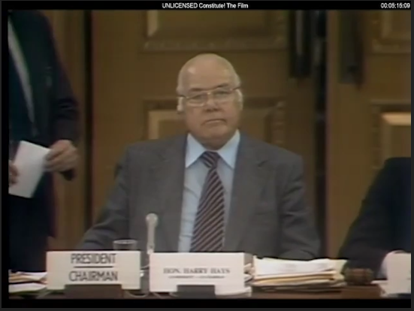
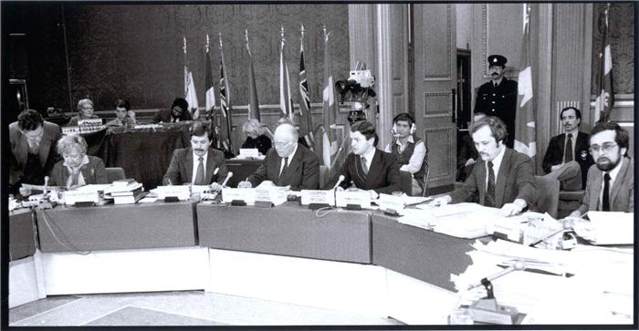
Hays-Joyal Joint Committee hearings

Slide 7
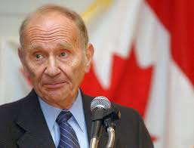
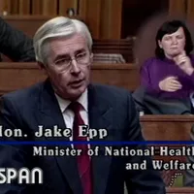
Borovoy and Epp comments
Alan Borovoy, General Counsel for the Canadian Civil Liberties Association:
“If you are talking about that which is generally accepted in a free and democratic society with a parliamentary form of government, you may well be talking about everything that Parliament or the legislatures have said is acceptable and to the extent that you are doing that, then it renders the entire charter a verbal illusion”

Slide 8
Limitations Clause – Section 1
Joint Committee (Hays-Joyal) 1981 - Addition of ‘reasonable’ and ‘demonstrably justified’ ensured accountability and requirement for a greater level of justification from government
Section 1 – Final wording:
“The Canadian Charter of Rights and Freedoms guarantees the rights and freedoms set out in it subject only to such reasonable limits prescribed by law as can be demonstrably justified in a free and democratic society.”

Slide 9
How to interpret?
Section 1 - The Canadian Charter of Rights and Freedoms guarantees the rights and freedoms set out in it subject only to such reasonable limits prescribed by law as can be demonstrably justified in a free and democratic society.
Reasonable limits? – what is a reasonable limit?
Prescribed by law? – what exactly does that mean?
Demonstrably justified? – how do you ‘demonstrably justify’?
Ask the court!

Slide 10
First things first:
The Court must first find a breach of a section of the Charter by a government law.
      Onus on rights claimant to establish the breach of a Charter right
      ‘Prescribed by law’ ensures rules are known, legislative debate has taken place
Then the government has the opportunity to justify its law before a court, using section 1 of the Charter – the justification clause
  Court must determine whether the breach is reasonable and justifiable in a free and democratic society

Slide 11

Section 1 Case -1986
R v Oakes
David Edwin Oakes found with small amount of hash oil, charged with possession for the purpose of trafficking
Section 8 of Narcotic Control Act stated that possession meant the intent to traffic – amount of drugs irrelevant
Onus is on accused to prove there is no intent to traffic
Potential for life imprisonment unless no intent
Pleads not guilty and challenges the law as a breach Charter section 11 d) – right to be presumed innocent until proven guilty

Slide 12
The Breach of a Charter right
The Court finds that section 8 of the Narcotic Control Act is a BREACH of section 11 d) of the Charter (right to be presumed innocent until proven guilty) because:
  Mr. Oakes is PRESUMED GUILTY of having the INTENT to traffic, rather than presumed innocent - the Crown Prosecutor must establish his guilt
  The amount of drugs in Mr. Oakes possession is irrelevant
  Oakes must prove he had no intent to traffic – this is a reverse onus. He must prove that he is innocent
  Reverse onus presumption for the purposes of trafficking violates the presumption of innocence – a Charter protected right.

Slide 13
Section 1 – the justification
The Canadian Charter of Rights and Freedoms guarantees the rights and freedoms set out in it subject only to such reasonable limits prescribed by law as can be demonstrably justified in a free and democratic society
The Court had to interpret section 1 of the Charter so that it could balance the breach of section 11 d) with government’s arguments for justifying section 8 of the Narcotic Control Act.

Slide 14


Slide 15
The Test – section 1
Oakes Test – 1986 SCC
Law must have pressing and substantial objective
Means chosen by the government to limit rights must be proportional to burden on rights:
  Objective of the law must be rationally connected to the law
  Limit/law must minimally impair the Charter right
  Means must balance effects - Overall balance or proportionality between benefits of the limit (law) and its harmful/deleterious effects on the right. Costs to rights holders vs benefits of the government law

Slide 16
Oakes Test
Pressing and substantial objective:
  Purpose or Objective must be important to society. Must be of sufficient importance to warrant overriding the right or freedom
  Oakes case – the purpose or objective of section 8, NCA is to prevent drug trafficking and ensure health and safety of the community
  Pressing and substantial objective? Yes

Slide 17
Oakes Test
Law has a pressing and substantial objective
2. Means used must be proportional to burden on rights:
  Objective must be rationally connected to the law
  Limit must minimally impair the Charter right
  Must be overall balance or proportionality between benefits of the limit and its harmful effects.

Slide 18
Oakes Test – a) rational connection
Limitation/law must be rationally connected to the objective of the law
      Law cannot be arbitrary, unfair or based on irrational considerations
  Oakes case:
          Objective of the law: to prevent drug trafficking – promote health and safety of the community
          No Rational Connection between objective and the law. Irrational to assume intent to traffic because a person is in possession of drugs
  Rational Connection? No

Slide 19
Oakes Test
1. Law has a pressing and substantial objective
2. Means used must be proportional to burden on rights:
  Objective must be rationally connected to the law
  Limit/law must minimally impair the Charter right
  Must be overall balance or proportionality between benefits of the limit and its harmful effects.
Result: Section 8 of the Narcotic Control Act unconstitutional - struck down

Slide 20
Oakes Test – b) minimum impairment
Limitation/law must minimally impair the Charter right
    The law must impair the Charter right as little as reasonably possible. If there is another, less impairing way to achieve its objective, government must choose it – within reason
Example:
Ford v Quebec (1988) – Quebec laws requiring exclusive use of French on signs breach freedom of expression - Charter section 2 b) fail Oakes test at minimal impairment stage: other less drastic means of protecting French language. Law is struck down

Slide 21
Oakes Test – c) proportionality
Balancing between overall benefits and harmful effects of the law
  State Action vs Charter right
  It remains possible that the severity of the deleterious (negative) effects of a law will not be justified by the purposes it is intended to serve, even if the objective is of sufficient importance, the measures rationally connected and the impairment a minimum.
  “this final step allows courts to stand back to determine … whether a rights infringement is justified in a free and democratic society. Although this examination entails difficult value judgments, it is preferable to make these judgments explicit, as doing so enhances the transparency and intelligibility of the ultimate decision. Further, proceeding to this final stage permits appropriate deference to Parliament’s choice of means, as well as its full legislative objective”. (Oakes)

Slide 22
Hutterian Brethren Case - 2009
Alberta law requiring photos on driver’s licenses breaches section 2a) of Charter – freedom of religion
Can the law be justified using section 1 of the Charter?
Pressing and Substantial objective? Purpose of the law: “maintaining the integrity of the driver’s licensing system in a way that minimizes the risk of identity theft” - yes
Proportional?
  Rational Connection – Objective rationally connected to law
  Minimal Impairment – Yes. Reasonably tailored to address problem of identity theft associated with drivers licenses
  c) Balance of burden and benefit – Negative impact on freedom of religion does not outweigh benefits to society of system that minimizes identity theft. Law is justified.
Notes:
Critiques: 1) not minimally impairing – other ways to prevent identity theft, 2) to impose on Hutterites a requirement that goes directly to their religious beliefs. Not peripheral. To impost this requirement on them makes it impossible for them to have driver’s licenses.

Slide 23
Oakes Test – Section 1
Law must have pressing and substantial objective
Means used must be proportional to burden on rights:
  Objective must be rationally connected to the law or policy
  Limit must minimally impair the Charter right
  Must be overall balance or proportionality between benefits of the limit/law and its deleterious effects.

Slide 24
Cases/laws failing Oakes test
R v Morgentaler – Section 7 breach. No rational connection b/n protection of women’s health and therapeutic abortion process requiring approval from 3 physicians for abortion. Law struck down
R v Nur – Section 12 breach - right not to be subjected to cruel and unusual punishment. 3-year sentence (mandatory minimum) for possession of an illegal weapon. Not minimally impairing (step 2 b). Other ways to achieve objective of deterrence for possession of illegal weapons. Law struck down
R v Carter – Section 7 breach. Life, liberty, security of the person. Law that absolutely prohibits physician-assisted dying is not minimally impairing. Law struck down
Notes:
An absolute prohibition on physician-assisted dying is rationally connected to the goal of protecting the vulnerable from taking their life in times of weakness, because prohibiting an activity that poses certain risks is a rational method of curtailing the risks. But the law is not minimally impairing – - vulnerability can be assessed on an individual basis, using the procedures that physicians apply in their assessment of informed consent and decisional capacity in the context of medical decision-making more generally. The absolute prohibition is therefore not minimally impairing

Slide 25
Pandemic Issues
Federal Government mandates hotel quarantine upon entry
  COVID-19 Emergency Orders in Council (OIC) pursuant to section 58 of the Quarantine Act in effect - makes the annexed Minimizing the Risk of Exposure to COVID-19 in Canada Order (Quarantine, Isolation and Other Obligations).
Newfoundland Government prohibiting entry – Taylor case
Limitations on indoor gatherings including church services

Slide 27
Federal Restrictions: Air traveller requirements:
Travellers must provide proof of a negative COVID-19 molecular test taken up to 72 hours before their scheduled departure time.
As of February 21, 2021, at 11:59 pm ET, travellers, unless exempted, will also be required to:
  reserve a government-authorized hotel for 3 nights prior to departure to Canada
  take a COVID-19 molecular test on arrival in Canada
  stay in the government-authorized hotel while awaiting the results of the COVID-19 molecular test taken on arrival
  pay for the cost of the hotel stay, as well as all associated costs for:
    Food, security, transportation, infection prevention and control measures
Travellers must present proof of having reserved and pre-paid for their accommodation through ArriveCAN.
Travellers will still be required to complete the remainder of the mandatory 14-day quarantine after their mandatory hotel stopover.

Slide 28
The OakesTest – section 1
Law – Quarantine Act, section 58
Breach – possible section 7 Charter breach – life, liberty, security of the person
Section 1 Justification
Pressing and substantial objective?
Means chosen must be proportional to burden on rights:
  Objective must be rationally connected to the limit on Charter right
  Limit must minimally impair the Charter right
  Overall balance or proportionality between benefits of the limit and its deleterious effects. Means must balance effects

Slide 29
Oakes – Part 1 – Pressing and Substantial Objective?
Government purpose as stated on its website will likely be found to be pressing and substantial:
Whereas the Governor in Council is of the opinion, based on the declaration of a pandemic by the World Health Organization, that there is an outbreak of a communicable disease, namely coronavirus disease 2019 (COVID-19), in the majority of foreign countries;
Whereas the Governor in Council is of the opinion that the introduction or spread of the disease would pose an imminent and severe risk to public health in Canada;
Whereas the Governor in Council is of the opinion that the entry of persons into Canada who have recently been in a foreign country may introduce or contribute to the spread of the disease in Canada or new variants of the virus causing COVID-19 that pose risks that differ from those posed by other variants but that are equivalent or more serious;
And whereas the Governor in Council is of the opinion that no reasonable alternatives to prevent the introduction or spread of the disease are available

Slide 30
Part 2 a) – rational connection?
Objective: To limit the spread of COVID-19, entry of persons into Canada who have recently been in a foreign country may introduce or contribute to the spread of the disease in Canada or new variants of the virus causing COVID-19 that pose risks that differ from those posed by other variants but that are equivalent or more serious
OR
Objective To discourage Canadians from travelling abroad, and to discourage travellers generally from entering Canada
Law:
Negative COVID19 test taken within 72 hours before
Government-approved hotel for 3 nights
  At the traveler’s expense: All expenses for food, security, transportation, infection prevention and control measures
  Provide proof of hotel reservation and pre-payment
  Required to complete 14-day mandatory quarantine after 3-day hotel stay and negative test

Slide 31
Problems with the law
May discourage non-essential travel, but, in terms of preventing COVID spread:
  3-day stay in hotel is not long enough to catch every potential infection. Incubation is 5-7 days. Only sufficient to process PCR test;
  Those vaccinated in the US are still subjected to the process of booking and paying for a hotel for 3 days;
  No controls in place for moving international travellers from the airport to quarantine hotels – can use taxis, shuttles, their own cars. Might stop along the way;
  Hotel staff have to ensure travellers stay in their hotel rooms. Limited training for preventing of infectious diseases;
  Essential workers such as truck drivers and health care workers exempted from 3-day hotel stay at the border

Slide 32
Part 2 b) – minimum impairment?
Is a mandatory 3-day hotel stay the least drastic way to achieve the objective?
  Stop spread from countries outside Canada
  Discourage travel outside Canada
  Catch disease quickly from other countries
Other options?
  Regular checks on those who are isolating at home
  Exemptions for those who are vulnerable – the elderly, those with disabilities
  Mandatory 14-day stay in gov’t facility as in other countries such as Australia

Slide 33
Part 2 c) – balancing/proportionality
Importance of weighing costs to rights holders against benefits of the government law or policy
Life, liberty, security of the person important Charter rights
Balance against:
The 3-day mandatory hotel stay, enormous emotional cost to some vulnerable people, high actual cost, doesn’t seem to meet the government’s objective of reducing COVID spread

Slide 34
Taylor v Newfoundland, 2020 NLSC 125
Restriction of mobility between provinces – prohibiting entry to Newfoundland
  Ms. Taylor wanted to attend her mother’s funeral. Sought an exemption from the travel restriction imposed by Nfld, but was denied entry
  Public Health Protection and Promotion Act – orders restricting those permitted to enter
  Ms. Taylor filed a Charter challenge - section 6 mobility rights, and section 7 rights to life, liberty and security of the person
  Court finds section 6 breach - Mobility rights include the right to move within Canada

Slide 35
Section 1 – Is the breach of section 6 justifiable?
Preliminary comments:
Yardstick by which the travel restriction is to be measured are the values and principles essential to a free and democratic society
Context has been described as the “indispensable handmaiden” to the section 1 analysis – need to canvass the nature of the social problem that the legislation addresses
“Legislature is not required to provide scientific proof based on concrete evidence of the problem it seeks to address in every case” (Harper) Court can rely on logic, reason, and the application of common sense to what is known

Slide 36
Objective – Reasonable and Justifiable?
Objective: To protect those in Nfld and Lab from illness and death arising from importation and spread of COVID-19 by travelers
Applicant argues that the real objective is to ‘flatten the curve’ by preventing non-residents, such as Ms. Taylor, from entering the province. Restriction unnecessary because of few cases
Court disagrees
  Evidence from experts that when small # of cases, just a few imported cases may double the number of active cases
  Growth rate of COVID-19 exponential in populations with little immunity
  Restrictions were introduced to protect from importation and spread
  Concern that people might come to Nfld to avoid COVID-19

Slide 37
Rational Connection?
Objective: To protect those in Nfld and Lab from illness and death arising from importation and spread of COVID-19 by travelers
Court finds there is a rational connection between the Orders to restrict entrance to Nfld and Lab and the objective
Empirical evidence is not necessary to establish a rational connection, but government provided convincing evidence of the effectiveness of the travel restriction

Slide 38
Minimally Impairing?
Court – are there reasonably feasible and less impairing alternatives to achieve the same objective (454)
  Business of government is a practical one
  With benefit of hindsight it is possible for imaginative counsel to posit alternatives. Resourceful counsel can multiply the alternatives (455)
  Courts do not have expertise to second guess decisions of public health officials (458)
  Public health response to COVID-19 evolving – consider April 2020
  Public health response is to err on the side of caution
  No one-size fits all. Provincial responses differ given populations
  Self isolation not reliable - not viable substitute for travel restriction
  Testing of incoming travelers cannot be relied upon (30% failure)
  Contact Tracing does not prevent importation of COVID-19 but useful in conjunction with travel restrictions
  Travel restrictions aimed at non-essential travel are regularly reassessed

Slide 39
Balancing – Objective with Effects
Is there proportionality between:
the negative effects of the travel restriction on mobility rights and
the positive objective - to protect those in Newfoundland and Labrador from illness and death arising from importation and spread of COVID-19 by travelers
Court: “Question is, whether the harm done by restricting travel to the province outweighs the benefit to the public gained through the prevention, or at least the reduction of COVID-19 in the province. To ask the question is to answer it…. The collective benefit to the population as a whole must prevail"

Slide 40
Considerations
Is ‘better safe than sorry’ ok for a democracy that protects fundamental rights?
Court should not give too much deference to the government especially during a pandemic
Arbitrariness – Taylor’s sister could have entered, but not Taylor
Measures that are considered reasonable at one time, may not be in another

Slide 41

Grace Life Church and Pastor Coates

Slide 42
Grace Life vs Alberta Government
Church refuses to accept Alberta Government’s orders – restrict gatherings to 15% occupancy:
  Government indifferent to societal harms of lockdowns – depression, deprivation of congregants ability to practice their religion
  They obey their GOD not Government
  Argue their Charter protected freedom of religion is violated, and restrictions are not justifiable

Slide 43
Breach and Justification - hypothetical
Breach of Charter section 2 a) freedom of religion, 2 c) freedom of assembly, because of Government restrictions on in-person worship gatherings
Is the Alberta Government law restricting gatherings reasonable and justifiable?

Slide 44
Gov’t restrictions on in-person gatherings
Oakes Test
Gov’t justification (potential)
Pressing and substantial objective?
Proportional?
  Rationally connected
  Minimally impairing
  Balance of harmful effects vs objective
To reduce spread of COVID-19 – Health, safety
Proportional?
  Limiting the number of people who can gather will reduce the spread
  Given the science, and numbers of COVID cases, this is the safest approach
  Protection of the public more important than freedom of religion for a small group

Slide 45
Gov’t restrictions on in-person gatherings
Gov’t Justification (potential)
Church Arguments (potential)
To reduce spread of COVID-19 – Health, safety
Proportional?
  Limiting the number of people who can gather will reduce the spread
  Given the science, and numbers, there are no other reasonable measures available
  Protection of the public more important than freedom of religion for a small group
To reduce spread of COVID-19 by limiting numbers to 15%
Proportional?
  No rational connection - 15 % is arbitrary. No evidence to support reduction of spread
  Not minimally impairing. Effects on congregants severe. No science to support this restriction. COVID is like flu
  Not proportional - Freedom of religion is a critical freedom. Deleterious effects on ability to practice faith far outweigh perceived risks of spread

Slide 46
Section 1 – Concluding Thoughts
Oakes test has withstood test of time (35 yrs)
Legislative branch and judicial branch meet at section 1
Critics charge that the section allows too much judicial morality – esp. final stage
May be less deference to government as new evidence on the pandemic emerges and vaccines are more prevalent

Slide 47

Questions?

